Slide 1
Game Technology
Lecture 11 – 16.01.2015
Dipl-Inf. Robert Konrad
Dr.-Ing. Florian Mehm

Slide 2
Preliminary timetable
Lecture No. | Date | Topic
1 | 17.10.2014 | Basic Input & Output
2 | 24.10.2014 | Timing & Basic Game Mechanics
3 | 31.10.2014 | Software Rendering 1
4 | 07.11.2014 | Software Rendering 2
5 | 14.11.2014 | Basic Hardware Rendering
6 | 21.11.2014 | Animations
7 | 28.11.2014 | Physically-based Rendering
8 | 05.12.2014 | Physics 1
9 | 12.12.2014 | Physics 2
10 | 19.12.2014 | Procedural Content Generation
11 | 16.01.2015 | Compression & Streaming
12 | 23.01.2015 | Multiplayer
13 | 30.01.2015 | Audio
14 | 06.02.2015 | Scripting
15 | 13.02.2015 | AI

Slide 3
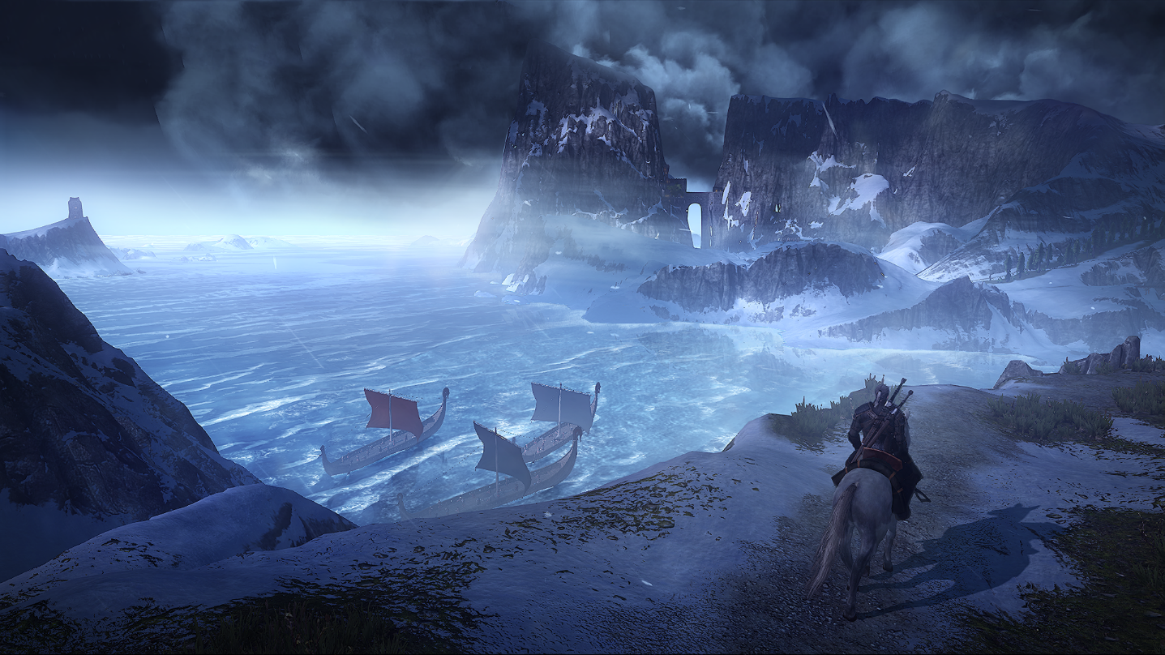


Slide 4
Today‘s Games
Typical hardware requirements
8 GiB RAM
2 GiB Video-RAM
50 GiB on disk
All SNES games ever (including all language versions)
~3000 games
~4.5 GiB

Slide 5
Today‘s Data
One uncompressed texture
4096 x 4096 x 4 Bytes = 67108864 Bytes = 64 MiB
2 GiB / 64 MiB = 32
Physically based rendering – typically 4 textures

Slide 6
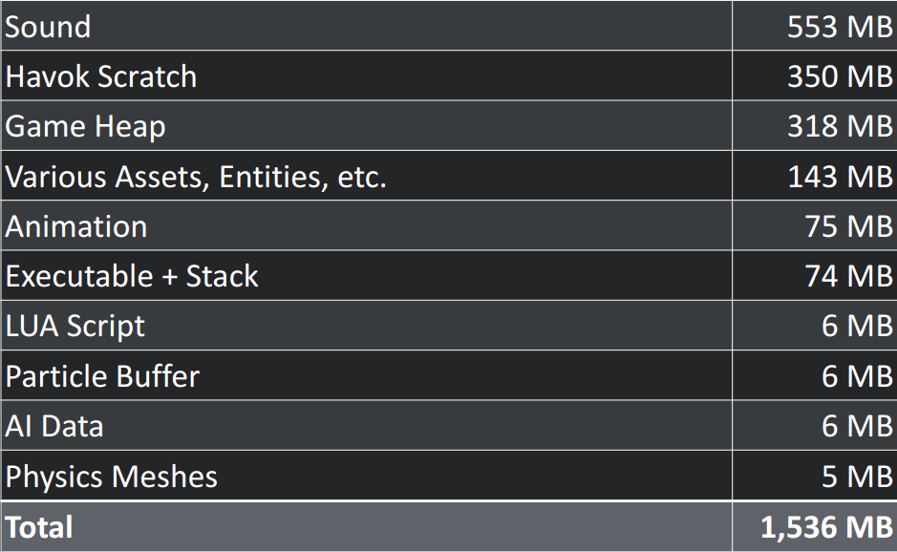
Killzone 4 CPU data

Slide 7
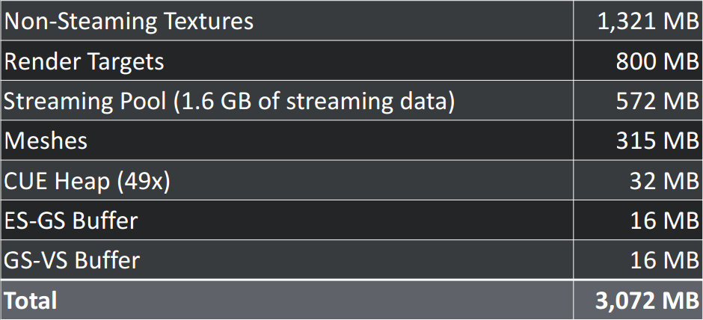
Killzone 4 GPU data

Slide 8
PNG and JPEG
PNG
Lossless
Compression highly dependent on image content
JPEG
Lossy
Generally strong compression
Both
Slow decompression
Can slow down loading times
Not possible to access a single pixel while compressed
Not usable for image computations aka not usable as a texture format

Slide 9
Texture Compression
Many different formats
S3TC, PVRTC, ASTC,…
Has to be supported by GPU and Graphics API
Of course much of it is patented and hard to standardize
Design goals
High compression
Low visual degradation
Efficient single pixel access
Constant size of a pixel or a pixel block

Slide 10
Possible compression strategies
Less than 8 bits per color might be ok
The eye‘s color resolution is less then its intensity resolution
Neighboring pixels likely have similar colors

Slide 11
Example 1
ETC
Ericsson Texture Compression
Compresses 4x4 pixel blocks to 64 bits
Split into two 2x4 groups
Each gets a 12 bit base color plus 3 bit brightness range selection
Each pixel gets a 2 bit offset value

Slide 12
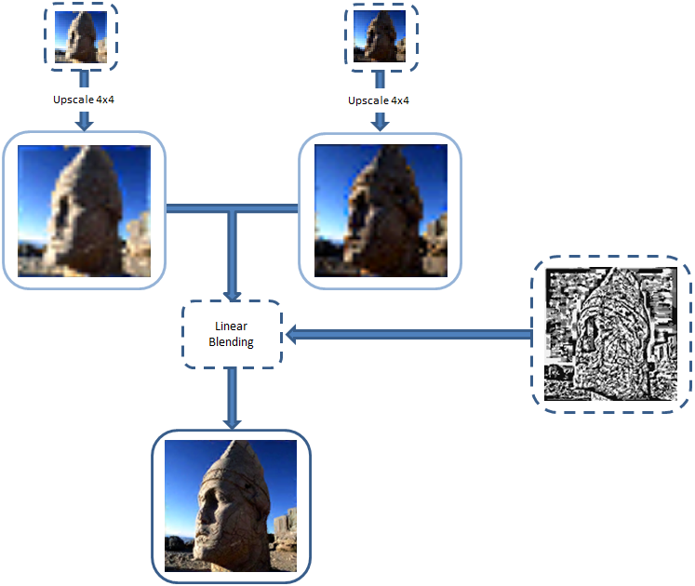
Example 2
PVRTC
PowerVR Texture Compression

Slide 13
Normal Maps,…
Compression for images might not be optimal for other textures
But it might just work
Swizzling channels can help
3Dc
x²+y²+z²=1
z²=1-x²-y²
One value can be omitted
Plus block compression

Slide 14
Manual Compression
Let the artists do the job
Repeat images over and over
Nobody might notice it when you do it cleverly

Slide 15
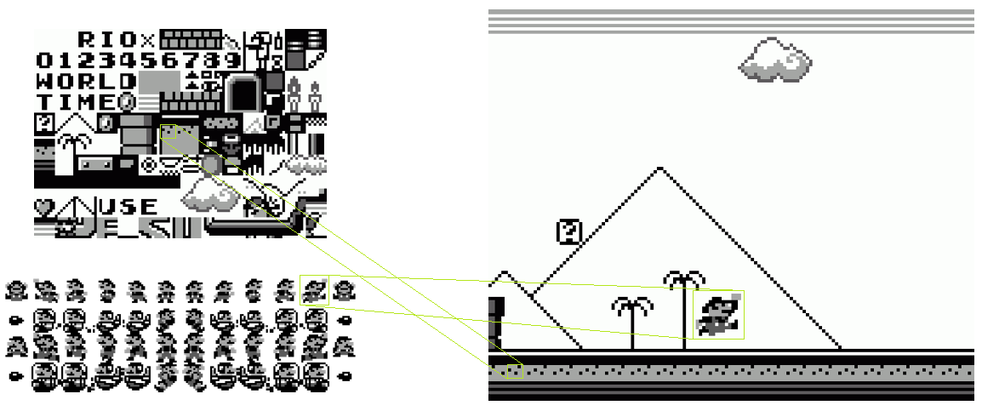
Tilemaps/Tilesets

Slide 16
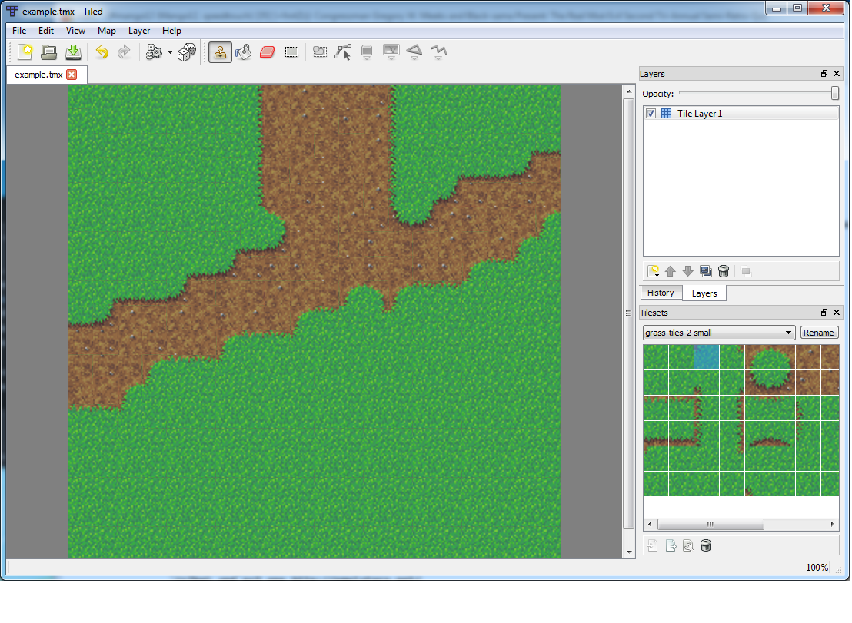
Tile Editors

Slide 17

Pitfall: The Mayan Adventure

Slide 18
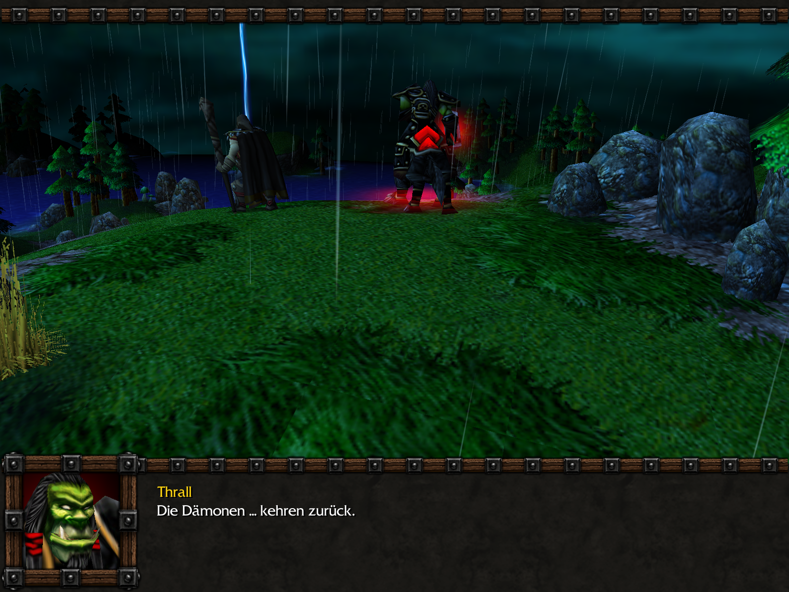
Warcraft 3

Slide 19
Tilemaps in 3D
Bilinear Filtering
Would have to use texels from two tiles at tile boundaries
Complicated
Expensive
Rarely used

Slide 20
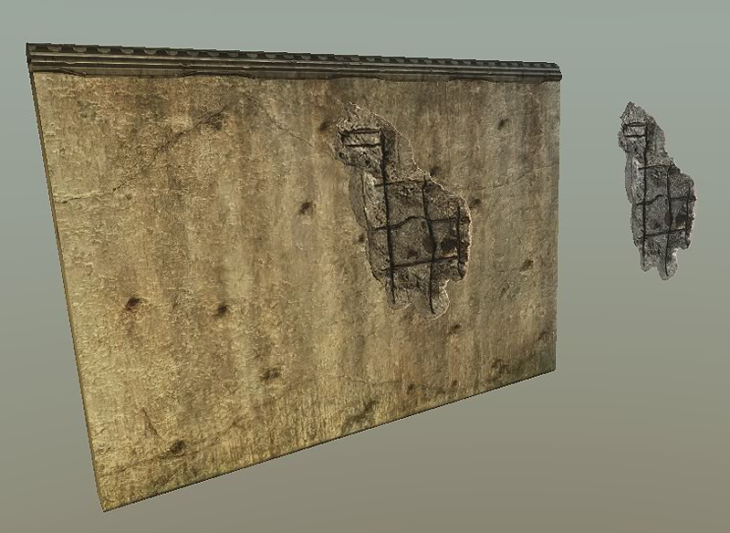
Multitexturing

Slide 21
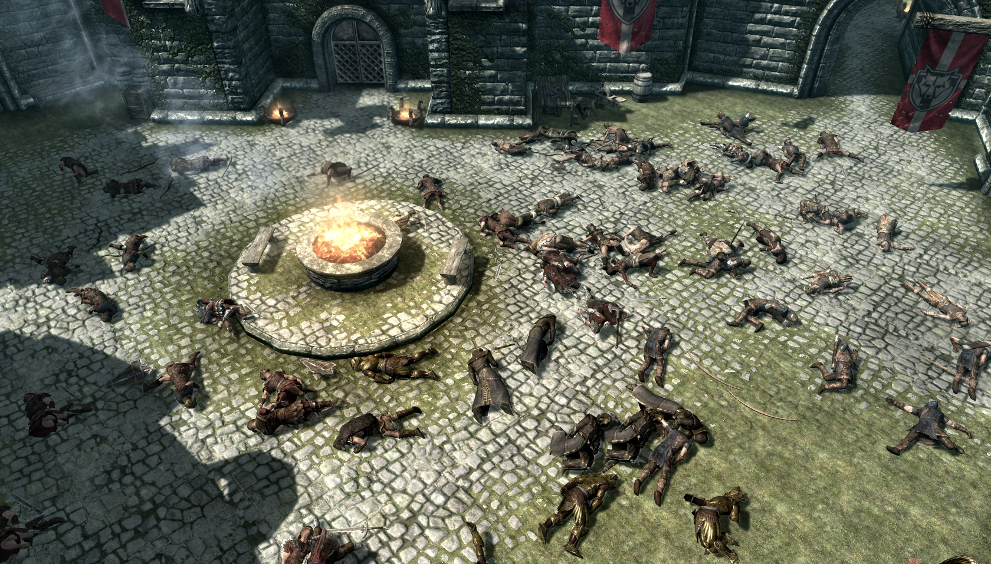
Multitexturing

Slide 22
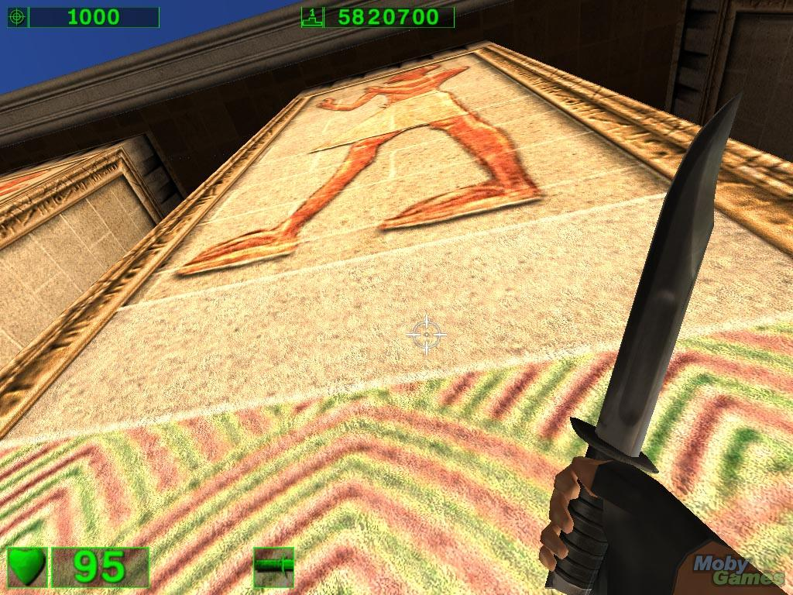
Multitexturing

Slide 23
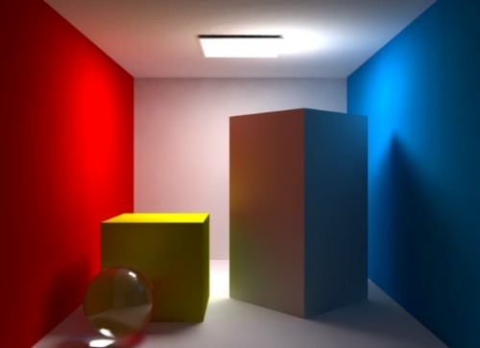
Good lighting can hide a lack of details

Slide 24
Problems
Performance
More textures, less performance
Precalculating which polys actually use more textures can help
Needs good tool support
Scary communication with artists

Slide 25
Streaming
Coarse Streaming
Load and replace complete assets
Fine Grained Streaming
Load and show/play a single asset bit by bit

Slide 26
Coarse Streaming
Similar to level of detail systems
Load big textures for near objects
Kick out big textures for far away objects
Maybe blend texture changes in and out

Slide 27
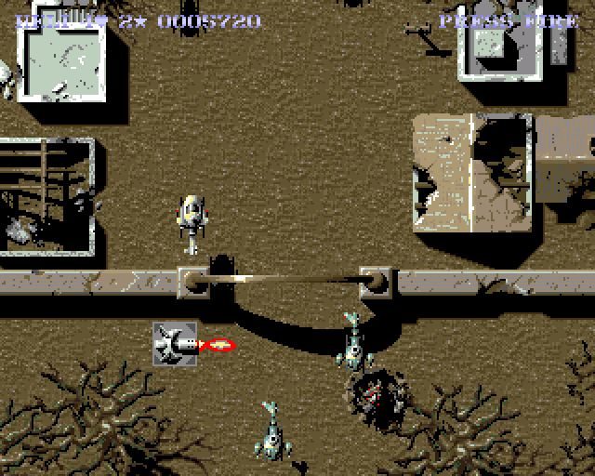
SWIV

Slide 28
Problems
Disks are slow and unreliable
No timing guarantees at all
Load textures in a second thread, always have an emergency strategy ready (keep super low resolution textures of everything in RAM)
Changing textures at runtime is problematic
Driver might decide to convert the texture
Easier on console
Probably easier with Direct3D 12

Slide 29
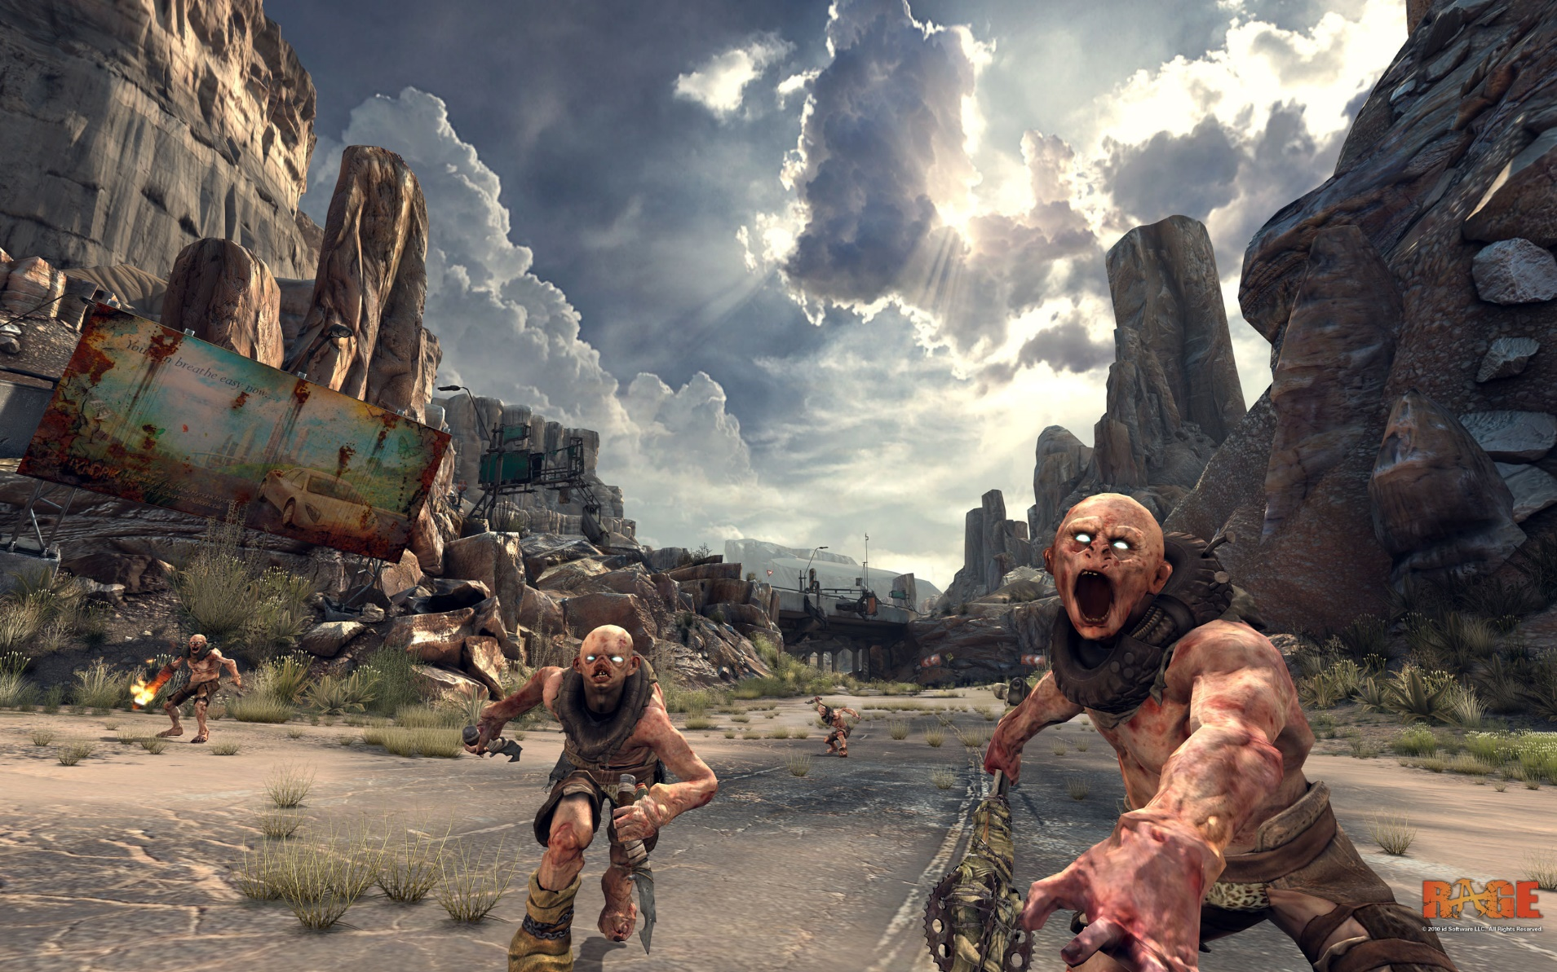
Fine grained texture streaming

Slide 30
MegaTextures
Really huge textures
Rage supports textures of up to 128000×128000
That‘s ~60 GiB
Compression
Texture is highly compressed on disk
Using lossy JPEG like compression
One texture for everything
Complete world in one texture
No restrictions for artists
But toolsets provide classical multitexturing tricks
Artists don‘t manually paint 128000x128000 pixels

Slide 31
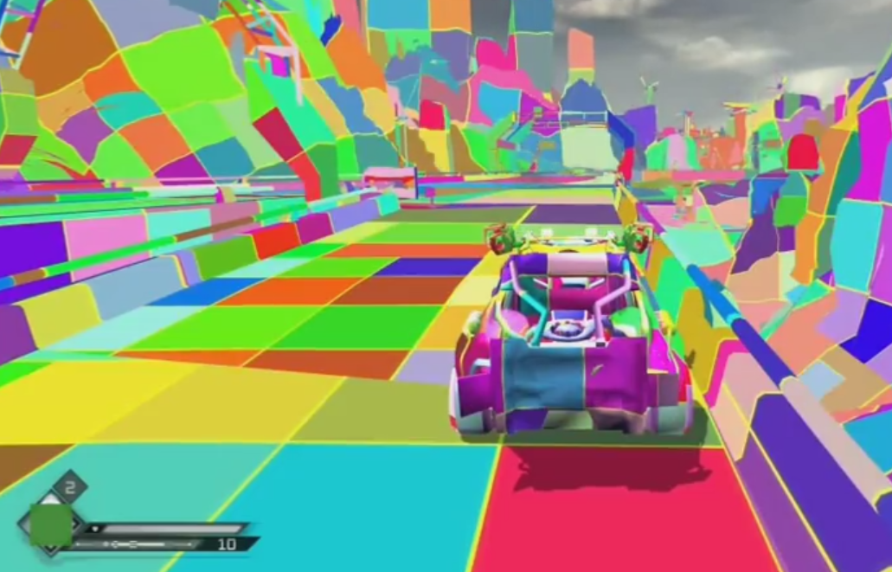
MegaTextures
Geometry is split up in tiles
Engine determines screen size of visible tiles
Loads texture parts in varying sizes to optimize current view

Slide 32
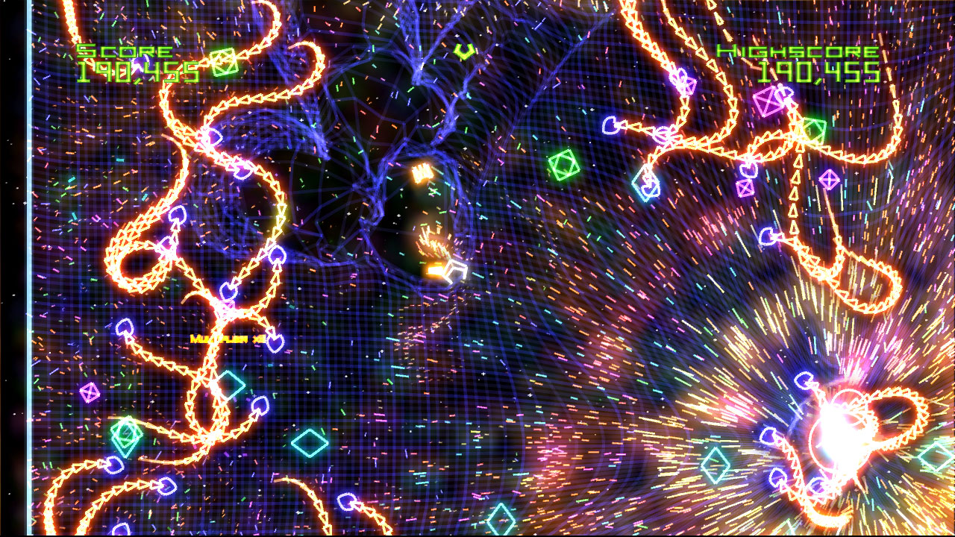
Geometry

Slide 33
Geometry Compression
Not widely used
No hardware support
Special strategies for animations
Like skeletal animations, which are tiny

Slide 34
Manual Compression

Slide 35
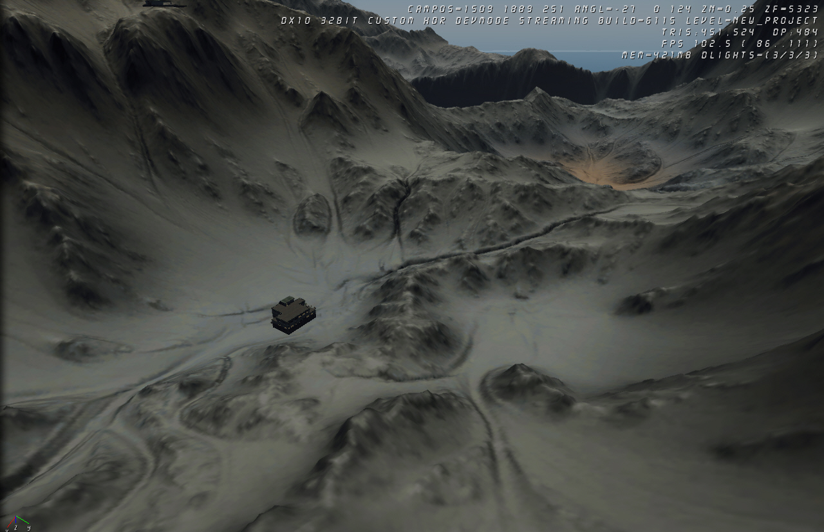
Height Maps
Just Y instead of X/Y/Z

Slide 36
Normal Maps
Remove super detailed geometry
Replace with normal maps
Which is a form of compression by itself
Plus normal can be further compressed

Slide 37
Coarse Geometry Streaming
Same strategies as for textures
Could be directly plugged into a level of detail system

Slide 38
Fine grained geometry streaming
To be done

Slide 39
Sound
mp3 and similar compressed formats
Nothing special – at least not anymore
Coarse streaming for sound effects
Easy
Sound effects are short
Sound effects don’t stay on screen
Sound effects can stay in CPU RAM
Fine grained streaming for music and maybe speech
Even mp3 players do it

Slide 40
Really Big Worlds
32 bit floats
“total precision is 24 bits (equivalent to log₁₀(2²⁴) ≈ 7.225 decimal digits)”
Can be a little tight for big worlds
Use 64 bit floats for positions
Hard to integrate 32 bit physics engines
Split and Shift the world
Split the world
Shift the closest parts to a position nearer at the camera

Slide 41
Profiling
Sampling
Samples at random intervals
Does not modify code
Instrumentation
Adds sampling code to binary

Slide 42
Performance Counters
CPU integrated circuitry that measures certain performance characteristics
Like number of cache misses,…
Can be read by CPU specific profiling tools

Slide 43
Task 2.1
We are trying to find a „non-convex hull“ of the points of the cities
A regular convex hull would not approximate our mental image of a „border“ between two regions

Slide 44
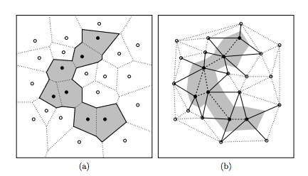
Task 2.1
Use the cells that contain the cities and visualize those areas
Maybe blur or soften the edges to make them rounder
What about „islands“?

Slide 45
Task 2.1
See Paper „What Is the Region Occupied by a Set of Points?” by Antony Galton and Matt Duckham for more info on the problem of “non-convex hulls” (http://www.geosensor.net/papers/galton06.GISCIENCE.pdf)

Slide 46
Task 2.2
Easier to see in 1D
An edge is a sudden change of function value
1D kernel:
-1 2 -1

Slide 47
Task 2.2
If all three pixels are constant:
p1 = p2 = p3 = c
Result = -1c + 2c – 1c
= 2c – 2c = 0
If the left pixel is different
p1 = c1, p2 = p3 = c2
Result = -1c1 + 2c2 –c2
= c2 – c1
→ Constant areas of the image become black, the edges remain

Slide 48
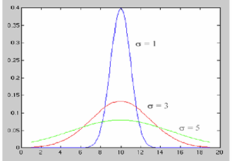
Task 2.3
With larger sigma, the curve doesn‘t reach as high, becomes more stretched out
The area under the curve stays the same
→ The curve becomes wider and is therefore visibly cut off and if we use the coefficients without normalizing, they will not add up to 1
Without normalizing, we will change the brightness of the image

